Slide 1

Transforming Server Maintenance with AI and TensorFlow
O'Neil Stefan Smith
University of West London
21500835@uwl.ac.uk

Slide 2
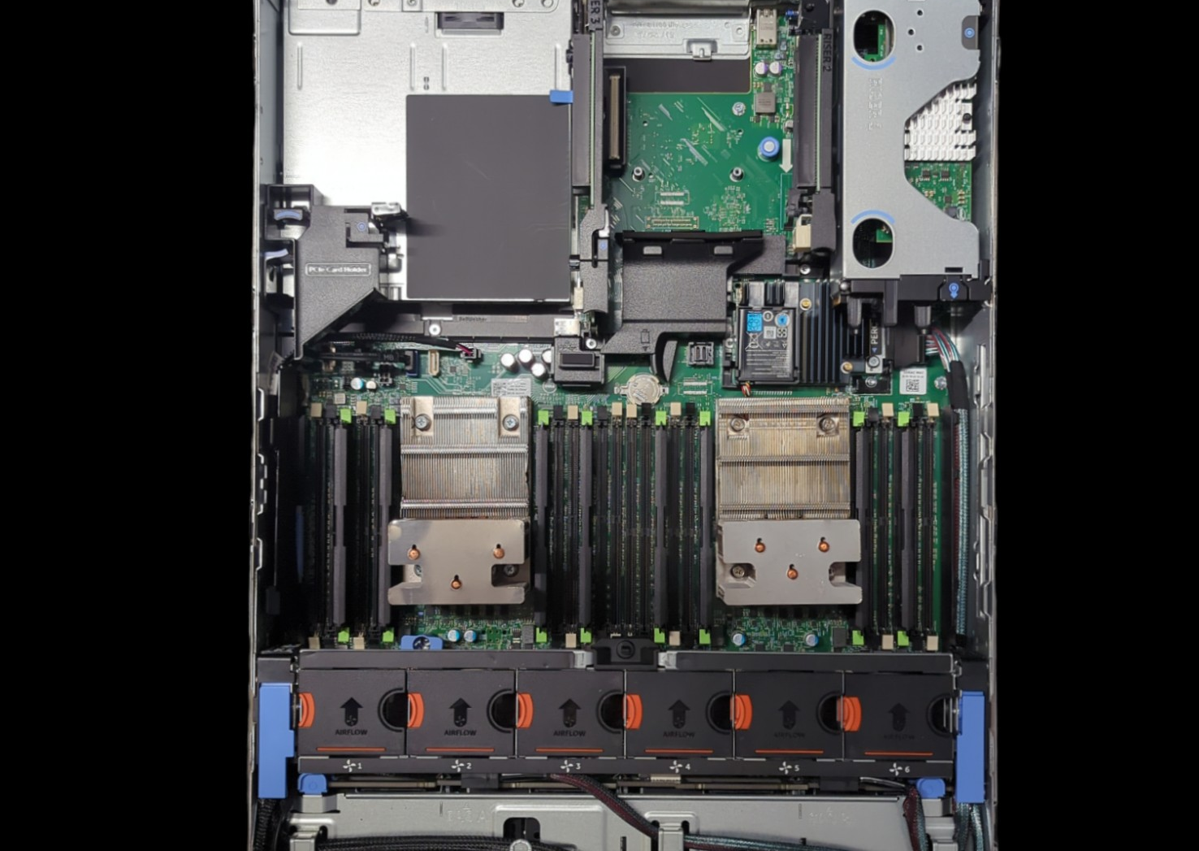
Introduction
Physical servers: The backbone of modern IT, crucial for business continuity.
Maintenance challenges: Traditional methods lead to downtime and costly repairs.
Our solution: Predictive maintenance using AI and TensorFlow.

Slide 3
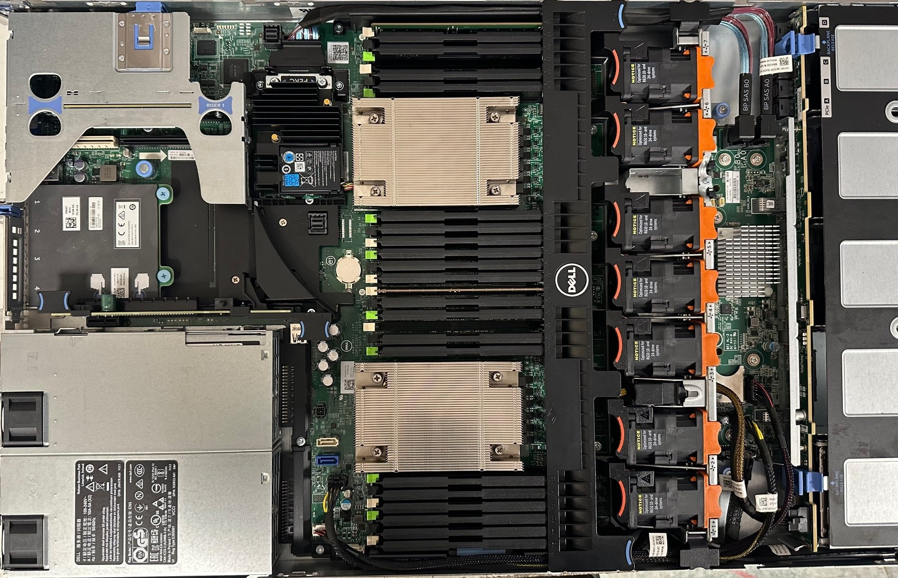
Data Collection
Source: Dell PowerEdge R630 servers.
Tool: Lifecycle Controller (embedded server management software).
Data points: CPU temperatures (individual cores), fan speeds (average).
Collection process
Boot server, enter Lifecycle Controller (F10).
Export SupportAssist collection (detailed diagnostics).
Manually transfer data to Excel, then convert to CSV.

Slide 4
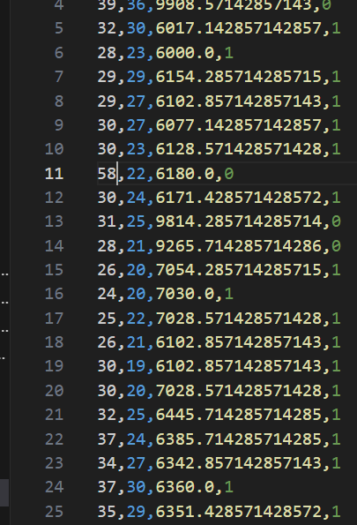
Data Challenges and Solutions
Manual data collection: Time-consuming but ensures accuracy and relevance.
Limited data points: Focus on CPU temperature and fan speed as primary indicators of server health.
Data cleaning: Address missing values and anomalies to ensure data quality.

Slide 5
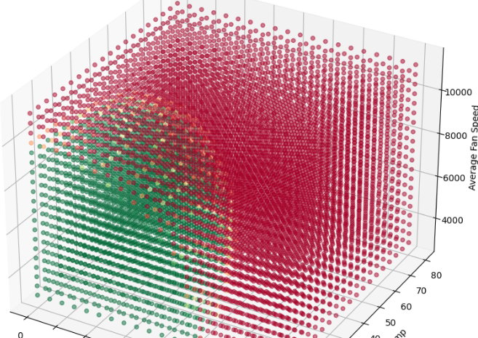
Final Model: A Deep Dive
TensorFlow and Keras: Powerful tools for building and training neural networks.
Model architecture:
Input layer: 128 neurons (ReLU activation).
Hidden layers: 2 layers, 128 neurons each (ReLU activation).
Output layer: 1 neuron (sigmoid activation for binary classification).
Training: 100 epochs, batch size 32, learning rate 0.01.
Scaling: MinMaxScaler for optimal neural network performance.

Slide 6

Model Evaluation and Results
Accuracy: Over 90% on test data.
Confusion matrix: Minimal false positives and false negatives.
Decision boundaries: Clear separation in 2D and 3D visualizations.
Real-time deployment: Successful implementation using Docker and Google Cloud AI Platform.

Slide 7
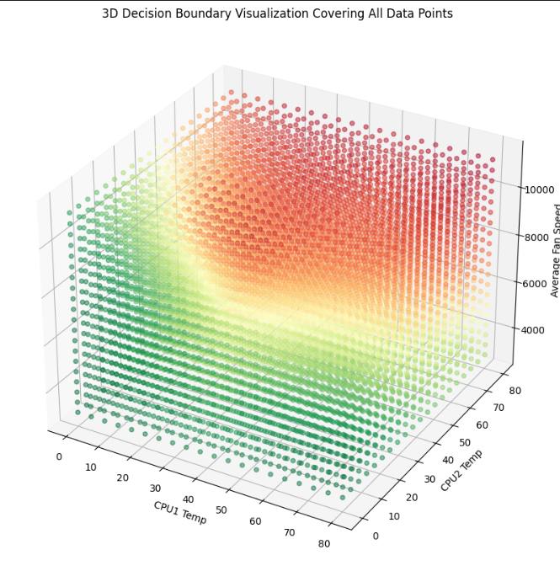
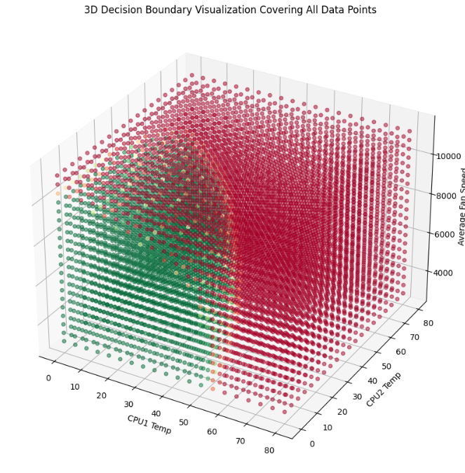
Conclusion
AI-powered predictive maintenance: A game-changer for server management.
Benefits: Reduced downtime, extended server lifespan, optimized efficiency.
Future work: Incorporate more sensor data, explore advanced algorithms, integrate into a comprehensive server management platform.

Slide 8

References
GitHub Repository:
https://github.com/Okazeil/ML_Final_project
Jack C.P. Cheng, Weiwei Chen (2020). Data-driven predictive maintenance planning framework for MEP components based on BIM and IoT using machine learning algorithms.
Vinayak Tyagi, Uday Chourasia, Priyanka Dixit, Alpana Pandey and Arundhati Arjaria (2020). A Survey: Predictive Maintenance Modelling using Machine Learning Techniques
Darren Miller (2023). Support Predictive Maintenance Analytics Workloads with Dell AI Starter Kit

Slide 9


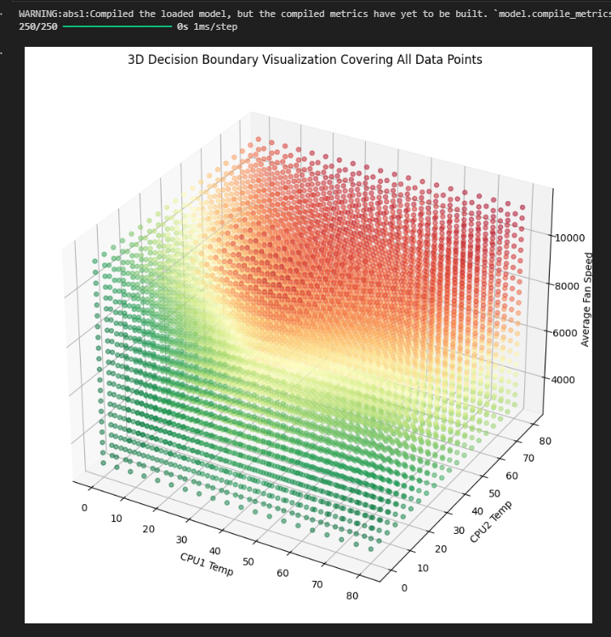
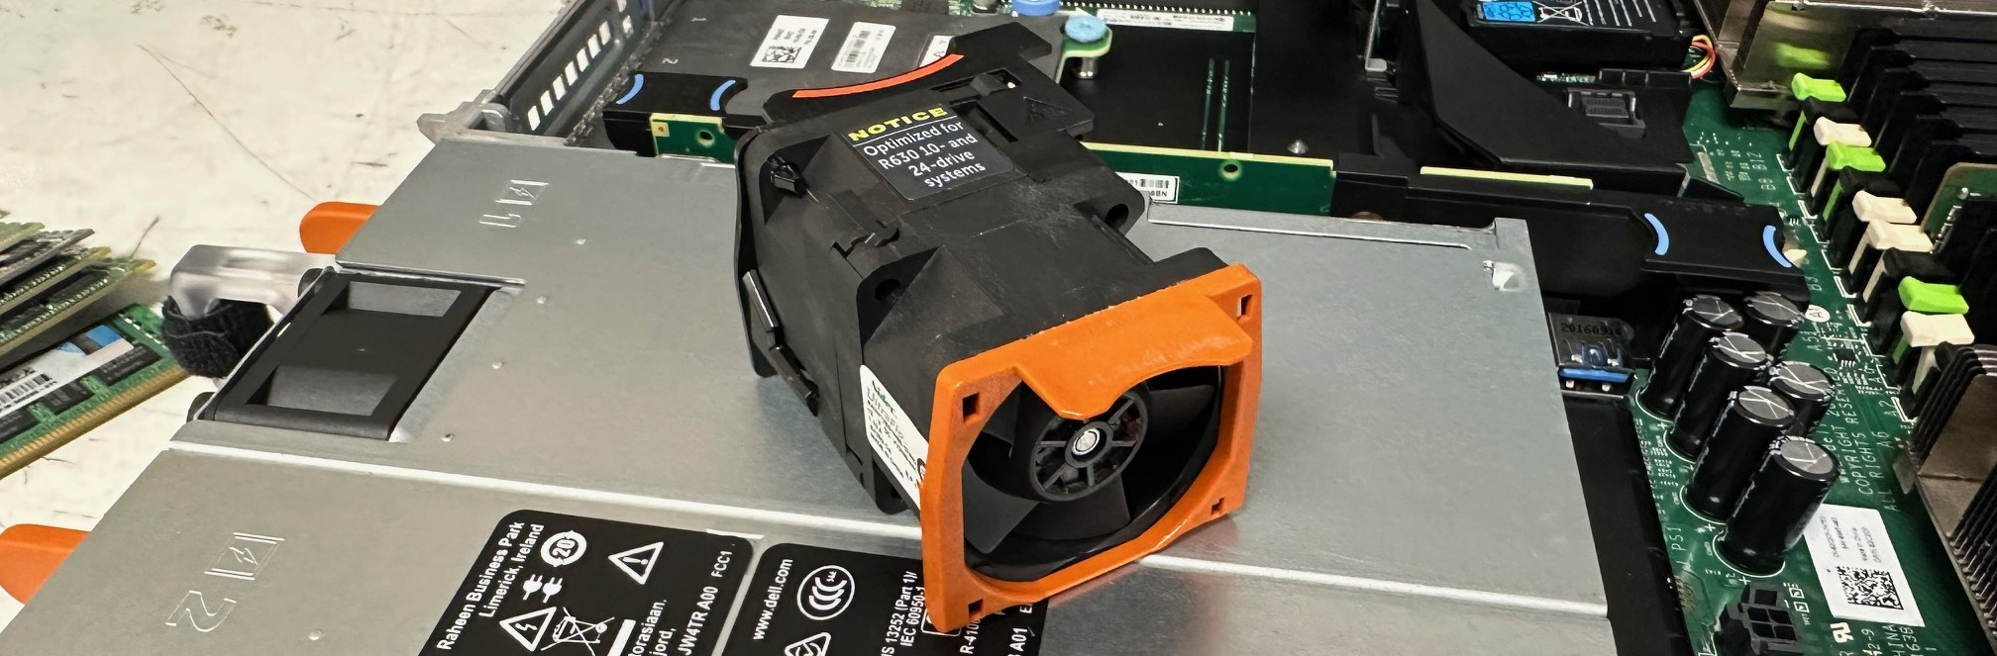
Transforming Server Maintenance with AI and TensorFlow
O’Neil Stefan Smith
Contact e-mail: 21500835@uwl.ac.uk
Abstract
Methodology
In today's data-driven world, the health and efficiency of physical servers are paramount. This research explores the application of AI, specifically TensorFlow, to revolutionize server maintenance. By analysing real-time sensor data, we've developed a predictive model that forecasts maintenance needs, enhancing server longevity and operational efficiency. This poster outlines our methodology, results, and the transformative impact of AI in server management.
Methodology
Data Collection: Gather sensor data from Dell PowerEdge R630 servers using the Lifecycle Controller.
Data Organization: Manually input data into an Excel workbook, then convert to CSV format.
Model Development: Build and train a neural network model using TensorFlow and Keras.
Model Evaluation: Assess model performance using accuracy, confusion matrix, and other metrics.
Deployment: Containerize the model using Docker and deploy on Google Cloud AI Platform.
Introduction
Physical servers are the backbone of modern IT infrastructures. Ensuring their optimal performance is crucial for business continuity. Traditional maintenance approaches often lead to unexpected downtime and costly repairs. This project introduces a predictive maintenance model using AI and TensorFlow to address these challenges.
Results
The final model achieved over 90% accuracy in predicting server maintenance needs.
Significantly reduced false positives and false negatives compared to the initial model.
Clear and accurate decision boundaries in 2D and 3D visualizations.
Successful real-time deployment using Docker and Google Cloud AI Platform.
Aims and Objectives
.
Develop a predictive maintenance model using TensorFlow.
Analyse real-time server sensor data (CPU temperature, fan speed).
Predict maintenance needs accurately.
Reduce downtime, extend server lifespan, and optimize efficiency.
Conclusions
This project demonstrates the transformative potential of AI and TensorFlow in predictive maintenance for servers. By proactively identifying maintenance needs, we can minimize downtime, extend server lifespan, and optimize operational efficiency. This data-driven approach represents a significant advancement in server management, ensuring the reliability and resilience of critical IT infrastructures.
References
Cheng, J. C. P. (2021). Data-driven predictive maintenance planning framework for MEP components based on BIM and IoT using machine learning algorithms. Automation in Construction, 121, 103426.
Kumar, U. (2018). The Importance of Servers in Today's Business World.
Forbes.Liulys, J. (2019). Machine Learning for Predictive Maintenance in Industry 4.0. Electronics, 8(11), 1368.
Susto, G. A., Schirru, A., Pampuri, S., McLoone, S., & Beghi, A. (2015). Machine Learning for Predictive Maintenance: A Multiple Classifier Approach. IEEE Transactions on Industrial Informatics, 11(3), 812-820.
Tyagi, V., Kumar, A., & Kumar, M. (2020). Predictive Maintenance of Industrial Machinery Using Machine Learning: A Review. Procedia Manufacturing, 48, 1044-1051.

